Slide 1
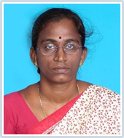


Visual Encryption using Pixel Property Permutation
Dr. Annapurani.K
Ms. Tazeen Ajmal
Mr. Ayush Surana
SRM Institute Of Science and Technology

Slide 2
contents
What is Data Encryption Need for Data Encryption
Visual Encryption
Proposed Idea
Visual Encryption by Pixel Property Permutation Step1: - Conversion and Compression of the Image Step2: - Extraction of Image Pixels Step3: - Random Permutations of the Pixel Property Step4: - Key-Generating Algorithm Step5: - AES Encryption of the Key and the Image Step6: - Decryption Process
Implementation
Conclusion

Slide 3

What is Data Encryption?
Data Encryption is the process of translating the data into another form or code such that only by the access to a secret key the data can be deciphered
The purpose of data encryption is to protect the digital data confidentiality as it is stored on computer systems and/or transmitted through computer networks

Slide 4
Need for data Encryption
In this data exhaustive world the amount of data stored is rising exponentially. These databases contains all kinds of personal information which needs to be properly secured.
To ENSURE PRIVACY
To ensure protection of data from the cyber Criminals.
For e.g. Even if a cyber criminal has gained access to our database. He will still not be able to accomplish the task of reading our data because it will be safely encrypted.
IT IS OUR LAST LINE OF DEFENSE

Slide 5

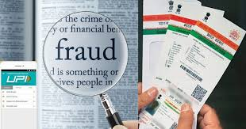
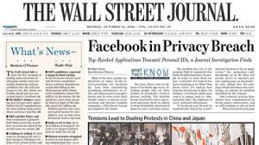



Slide 6
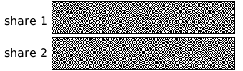
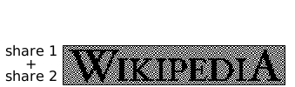
Visual Encryption
Visual Encryption is a cryptographic technique in which the data ( images, texts or videos ) are encrypted in such a way such that decryption is left upon to the user via sight reading.
Basic Visual Encryption technique is to divide an image into a number of transparent shares, thereby making it invisible for the intruder to read the image without a proper decryption key.
Visual Encryption by dividing the image into two shares.

Slide 7

PROPOSED IDEA and method
The Idea that has been proposed in this project can be subcategorized into three parts:-
Extraction of Pixel Values from The image.
This Image is then Converted into Black and White and compressed to 200*200 Pixels.
Permutation of the Pixel Values through randomized or predefined Algorithms.
Performing AES Encryption on the already encrypted image.
These keys are used to decrypt the Cipher key and the encrypted Image.
These two images are superimposed to each other to give the resultant image.
The resultant image passes through some denoising algorithms to give the original image.

Slide 8
Architecture of the PIXEL PROPERTY PERMUTATION

Slide 9
Stage 1:- compression and conversion of Image Pixels
Unstructered Data comprises of various different types of images like RGB Colour image which stores three different set of Pixel values Red, Green and Blue and Grey Scale
One approach towards conversion of an RGB color image into the Black and White image is to take each of the RGB values and convert it into one value that reflects the brightness of that pixel. (R + G +B)/3. 0.6G +0.2B + 0.2R.
For an RGB Image we have the Colour Bitmap vector and a Position Vector.
After converting the image, we have to compress the image without any loss to most of its features. Such a compression technology is termed as Lossless Compression. There are various algorithms to accomplish lossless compression differing on the quality of the compression to its varying complexity. There are various image formats that perform the lossless compression like PNG, GIF whereas there are some that uses some lossy methods like TIFF and MNG.

Slide 10
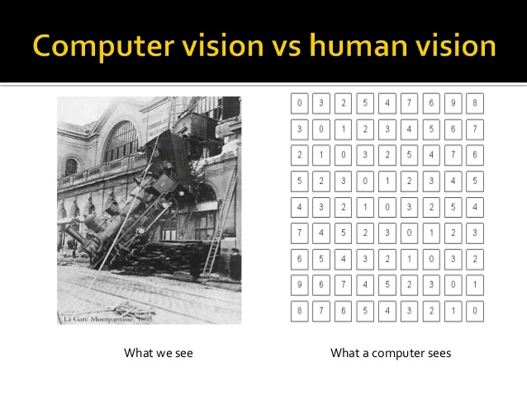
Stage 2:- Extraction of Image Pixels
We know that a Digital image is constituted of pixels. Using certain Digital Image Processing algorithms we can extract all those pixel values and say store them all in a matrix with its corresponding co-ordinates.
For an RGB Image Each Index of the matrix stores a Colour Bitmap Vector and the Position Vector
The complexity of extracting all the pixels is extremely small as a computer sees the image as a matrix of different pixel values.

Slide 11
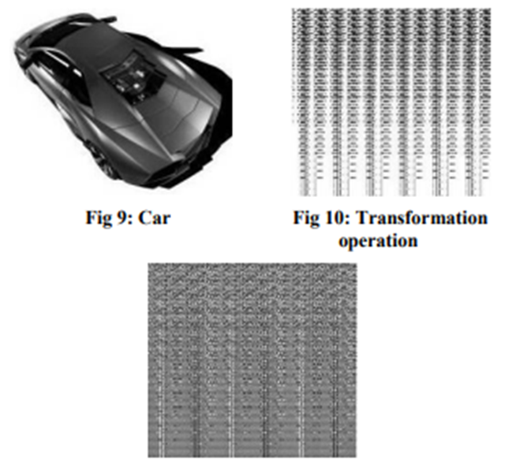
Stage 3: - Permutation of Image Pixels Extracted
After Extracting all the images obtained we send it to a transformation operation where the pixels obtained are permuted with one another and transferred to different co-ordinates.
This is a time exhaustive process as there can be as many as 255! Permutations possible which in turn significantly increases the security.
To increase the efficiency of the Encryption Process the values are permuted using a special Random Permutations.

Slide 12

FOR B/W IMAGE
• The Random Permutations used here is accomplished by using the Fisher-Yates Shuffle Algorithm also known as the Knuth Shuffle algorithm to shuffle the finite sequence of Numbers.
• Shuffle the Elements present in the i-th row with each other by selecting randomly a number and swapping it with the first index.
• The number that was selected is thus stroked out and is not taken into consideration.
• The same process is repeated for all the elements in a single row and in all the rows in the matrix.
• The above can also be accomplished using Columns instead of rows, but whichever convention is chosen needs to be followed till the end.
FOR GREY SCALE IMAGE
The pixel values in the image is constructed depending upon the amount or intensity of light.
The pixel values in this matrix comprises of an 8-bit binary value which indicates different shades of grey.
These values are stored in the W*H matrix, where W=width and H=height. All the bits of the 8-bit binary value of each and every pixel in the image are permuted with each other using the method described above.
The Process explained above takes Polynomial time complexity but which will exponentially increase if more Colors are to be Encoded and is taken into consideration.

Slide 13
FOR 24-BIT RGB IMAGE
All the index values in a Colour image consists of two different vectors, One is the Position Vector and the other a Colour Bitmap Vector(CBV).
The Position Vector contains the position of a particular pixel value. They are highly essential to track the position of that particular pixel after permutations.
The Colour bitmap Vector contains a 24 Bit flag indicating each colour value. There are a total of 2²⁴ values. A 0 would indicate the absence of a colour. And a 1 would indicate its presence.
The random permutations as explained earlier is done on the Colour Bitmap Vector which consist of either 0’s or 1’s.
After proper completion of these random Permutations we get an encrypted image which can not be deciphered without knowing the key.

Slide 14
Stage 4: - Key generating algorithm
The Encrypted PPP image obtained from the above step and the Plaintext Image obtained is used to generate the Key used for the decryption process.
Superimposing can be described as the process of combining multiple images and overlaying them on top of each other.
Superimposition of two-dimensional Images can cause for the production of moiré patterns., line moiré patterns and small scaling differences.
The key is generated using each of the 8- bit binary value of the image complementing them with each of the 8-bit binary pixel value of the PPP image. This key obtained can thus be used for the purpose of decrypting the GreyScale image.

Slide 15
Stage 5: - AES ENCRYPTION OF Key and Image
Another step of security is added by encrypting the key and the PPP image with AES Encryption technique, the most widely known encryption technique which has been found to be much faster than the earlier known standard DES. The AES encryption algorithm is used here as an added layer of defense which is not essentially necessary but encouraged for much greater security essential for highly sensitive data.

Slide 16
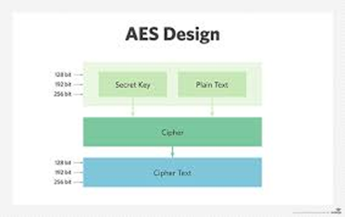
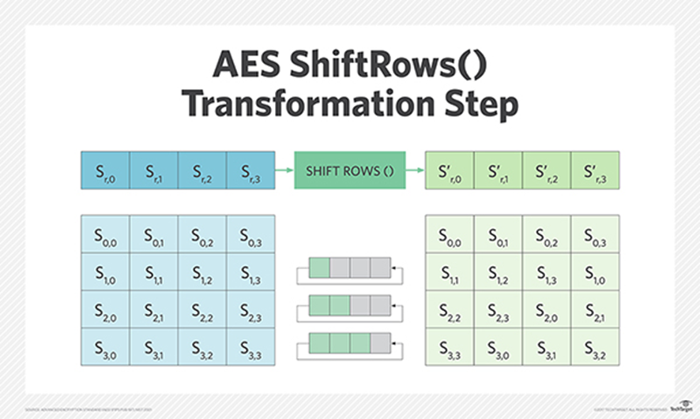
AES ALGORITHM
AES algorithm was derived from the Rijndael Cipher and ratified from the NIST as a successor to DES.
It is based on a block cipher Technique where data transformation is stored in an array and undergoes through a series of encryption rounds. 10 - 128 Bit 12 - 192 Bit 14 - 256 Bit This is thus the most secure form of encryption which is safer from most kinds of brute force attacks

Slide 17
Stage 6 :- Decryption Process

Slide 18


Implementation of the Encryption Algorithm PPP
INPUT IMAGE
Converted to B/W →

Slide 19

Implementation Continued…
Encrypted PPP Image
Cipher Key

Slide 20
Implementation Continued…
Output image

Slide 21
Cryptanalysis
Analyzing the proposed algorithm we found out that:-
Brute Force Analysis took (200*200)! Permutations more to crack. They are not feasible for any High Level Computer in Use today.
Cipher text only Analysis were highly impractical due to the Random Permutations used.
Chosen Plaintext Analysis could not be accomplished due to the use of random permutations.
Known Plaintext Analysis could greatly decrease the number of factorials by nearly half but still it would be highly to crack the encrypted image and would take a long time.
This technique was however not lossless as can be understood from the above graph
The analysis complexity was greater and when paralleled with AES it took nearly 50 milliseconds to encrypt an image
Along with AES encryption the encryption was increased by a huge margin.

Slide 22
Conclusion
The entire Idea behind having Visual Cryptography is to protect the data even after it has been stolen.
This mechanism If practised can be useful in helping large corporation secure unstructured data of its employees and customers from cyber criminals.
Data encryption of this type might seem like an unnecessary hazard to some but as it is often said “prevention is better than cure”.

Slide 23

Thank you
References
Roeder, Tom.:Symmetric-Key Cryptography.
Daniel J. Bernstein :Cache-timing attacks on AES in 2005
Andrey Bogdanoy, Dimitry Khovratovich and Christian Rechberger, :Biclique Cryptanalysis of the Full AES
S.El Assad, M. Farajallah, C. Vladeanu, :Chaos-Based Block Ciphers: An Overview, 2011
Zarko S. Stanisavljevic, :Data Encryption Standard Visual representation,1997
Sang-Su Lee, :Phase Masking Visual Cryptography using Interferometer. 2008
Schmeh, Klaus, :Cryptography and public key infrastructure on the Internet, p. 45 2001
Karthik Chandrashekar Iyer and Aravinda Subramanya,:Image Encryption by Pixel Property Separation
Min-Sung Koh, Esteban Rodriguez-Marek, Claudio Talarico,:A Novel Data Dependent Mulltimedia Encryption Algorithm secure against chosen Plaintext Attacks, ICME2007

